Slide 1

Introduction to Pirate Plots in R
Marta Topor, University of Surrey

Slide 2
R studio
YaRrr package (you can install during the session)
A CSV (excel) file with your data divided by groups
In this session we will work from a data file rather than simulated data. This will help to understand the steps you will need to take to make these plots using your own data.
What do I need?

Slide 3
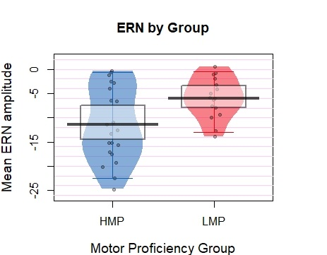
Why should I use pirate plots? - more information about the observed effect - better understanding of the effect and the studied groups - looks pretty and draws attention!
This is a an example plot for two experimental groups that comes from my recent study. The study was conducted on the general population with a median split. Here you can see that the LMP group forms a separate cluster compared to the participants in the other group. This shows that the median split was successful at separating a cluster of individuals from the general population as they differ on the variables of interest.

Slide 4
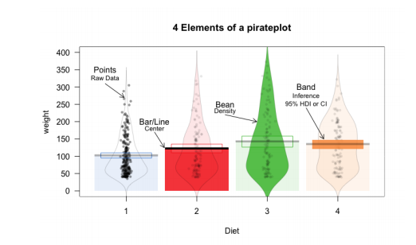
RDI plots – raw, descriptive and inferential data
Introduction to YaRrr package by Nathaniel Phillips, page 138
http://rpository.com/down/yarrr/YaRrr_ch09+10.pdf

